Slide 1
Coupling

Slide 2
Coupling:-
Coupling is the measure of the degree of interdependence between modules.
Tight coupling implies large dependence on the structure of one module by another because higher number of connections, more paths along which errors can extend in other parts of the program
Tight coupling makes modifying parts of the system difficult e.g. modifying a component affects all the component to which the component is connected.
Modules should have low coupling Loose coupling makes it possible to
Understand one class without reading others
Change one class without affecting others
Thus improves maintainability

Slide 3
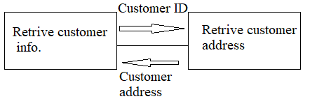
Types of coupling :-
Data coupling and stamp coupling
In this type of coupling .two modules interact by exchanging or passing data asa parameter
The dependency between module A and B is said to be data coupled if their dependency is based on the fact they communicated by only passing of data.
Other than communicating through out data the two modules are independent.

Slide 4
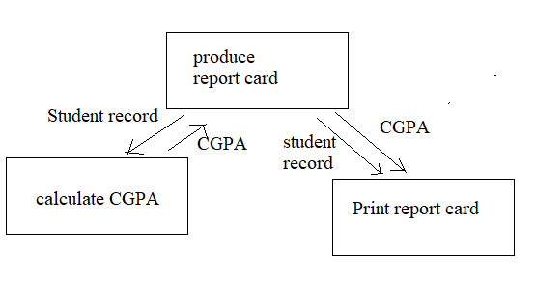
Two modules are data coupled if they communicate by passing parameters.
It is good because maintenance is easier and good design has high cohesion and weak coupling
Stamp coupling:-
Two modules are stamp coupled if they communicate via a passed data structure which contains more information than necessary for the modules to perform their functions.

Slide 5
Here student records contains name,address,SSN,outside activities ,medical information, contact names etc. in additional to academic performance information.
Why this is bad?
1.It affects understanding, because it not clear without reading entire module, which fields of record are accessed or changed.
2.Not reusable, other products have to use the same higher level data structures.
3.Pass more data than necessary.
We can reduce stamp coupling by passing single variables.
Ex public class Emailer
{
Public void send (Employee , string text)
{
….
}
}

Slide 6
Thank you

